Slide 1
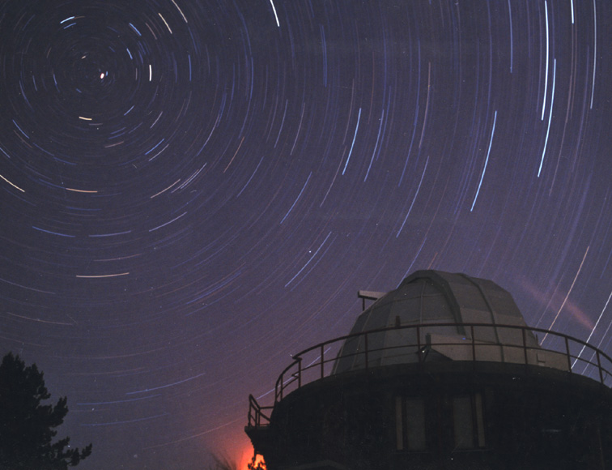


Spectral line analysis: log g
Spring School of Spectroscopic Data Analyses
8-12 April 2013
Astronomical Institute of the University of Wroclaw
Wroclaw, Poland
Giovanni Catanzaro
INAF - Osservatorio Astrofisico di Catania
Notes:
As we learn in the previous lecture, strengths abd shapes of spectral lines contain a great deal of informations about the star.
In this lecture we try to give some hints about several diagnostic methods concerning the gravity

Slide 2
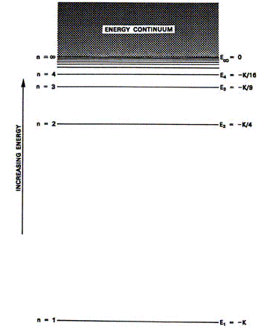
Spectral lines
Hydrogen Energy Levels
An absorption line is produced in a stellar spectrum whenever photons of energy E=hν=hc/λ=E_{U}-E_{L} are absorbed by an atom or ion that jumps from a lower to an upper energy level.
α
β
γ
Balmer
β
= R [ 1/n_{l}² – 1 /n_{u}²]
R = 3.288 x 10¹⁵ Hz
α
Lyman

Slide 3
Spectral lines
Hydrogen Energy Levels
Ionization Energy for Hydrogen
(n to infinity):
I = 13.6 eV (→ 912 Ǻ) ionization energy
Ι
χ_{n} excitation potential of the level n
χ₂ = 10.2 eV
χ₂
Notes:
Look at the energy involved in the transitions
We define ionization energy, the energy for a photon to release an electron
And excitation potential, the energy needed to allow an electron to jump in the next level

Slide 4
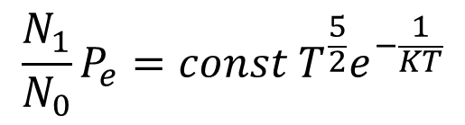
Spectral lines
The intensity of a spectral line is related to the number of absorbers, i.e. atoms or ions of the given elements at the lower level of the transition.
In LTE (Local Thermodynamic Equilibrium) the fraction of ions that can absorb is given by the Saha and Boltzmann equations.
Electron pressure → gravity
$$\frac{N_{1}}{N_{0}}P_{e}=const T^{\frac{5}{2}}e^{−\frac{1}{KT}}$$
Ionization - Saha
Element abundance
temperature
Excitation - Boltzmann
Notes:
In the Saha equation the electronic pressure enter in the left hand

Slide 5
Spectral lines
There are several mechanisms that broaden a spectral line, which is never a δ function (infinitely-narrow feature).
Natural atomic absorption
Pressure broadening
Thermal Doppler broadening
Microturbulence
Rotation
Etc.
Dispersion profile (Lorentzian)
Gaussian profile
Notes:
Spectral lines is than a lack of radiation of a given frequency, remember E=hv
It should be, in theory, a delta function but.... (slide)

Slide 6

Pressure broadening implies a collisional interaction between the atoms absorbing light and other particles: ions, electrons, atoms or molecules (in cool stars).
Change in energy of the levels induced by the collisions
$$∆E∝R^{−n}$$
Different types of pressure broadening
n | Type | Lines affected | Perturber
2 | Linear Stark | Hydrogen | Protons,electrons
4 | Quadratic Stark | Lines in hot stars | Ions, electrons
6 | Van der Waals | Lines in cool stars | Neutral hydrogen
Notes:
On the basis of the exponent n, we can have different of pressure broadening

Slide 7
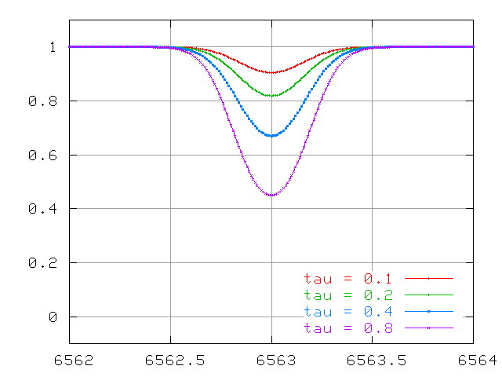
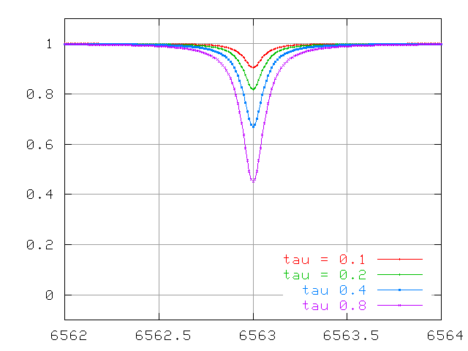
Spectral lines
“Weak” lines
Thermal Doppler profiles
Dispersion (Lorentzian) profiles
G(λ)
L(λ)
Both broadening mechanisms at work → the line is shaped by the convolution G(λ)*L(λ): “Voigt function”
Notes:
In a stellar spectrum, we distinguish between weak lines, «non-saturated», that is the core of the line not reach the 0 level

Slide 8
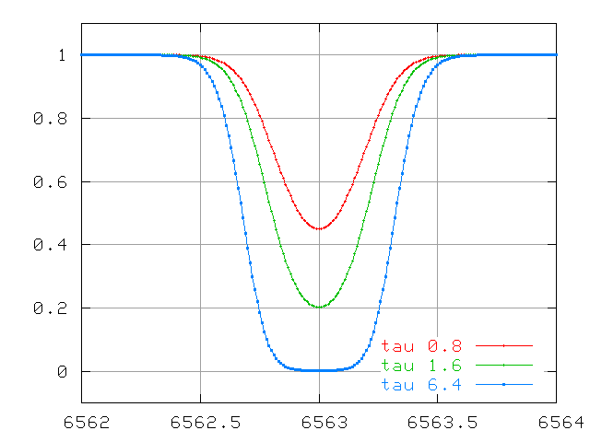
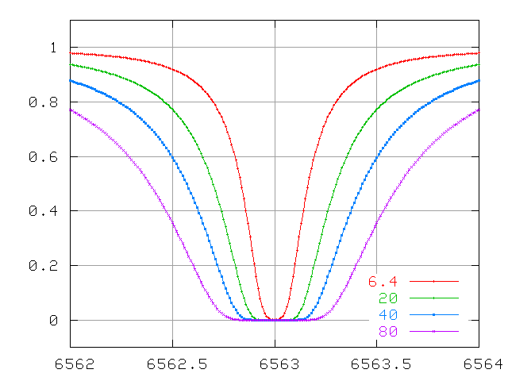
Spectral lines
“Strong” lines
Thermal Doppler profiles
Dispersion (Lorentzian) profiles
L(λ)
G(λ)
When the line intensity increases (e.g. abundance) the optical depth at the line center becomes high → the line core reaches a minimum level and the wings get broad. These lines are said “saturated”. Strong lines of abundant elements and ions (HI, NaI, MgII, CaI, CaII, etc.)
Notes:
And «saturated»strong lines

Slide 9
Spectral lines
normal
θ
To observer
ΔA
Δω
Star surface
Optical depth. k_{ν} , l_{ν} continuum and line absorption coefficients
Line transfer equation
Source function
j_{ν} emission coefficients
Notes:
Let recall some definitions we saw yestarday.
Iv is the specific intensity: the energy emitted in the direction theta (respect to the normal), from the element of area Delta A, in the element of solid angle Delta omega, in the unit of time and frequency
With analogues consideration, write again the equation of the optical depth, line transfer equation and source function

Slide 10
Spectral lines
The solution of transfer equation gives the emerging flux (at the top of the atmosphere τ_{ν}=0) as:
Numerical solution!
E₂ exponential integral of order 2
To a first, rough approximation:
In LTE the source function at τ_{ν} is the Planck function evaluated at T(τ_{ν}) → S_{ν} is decreasing outwards
For

Slide 11
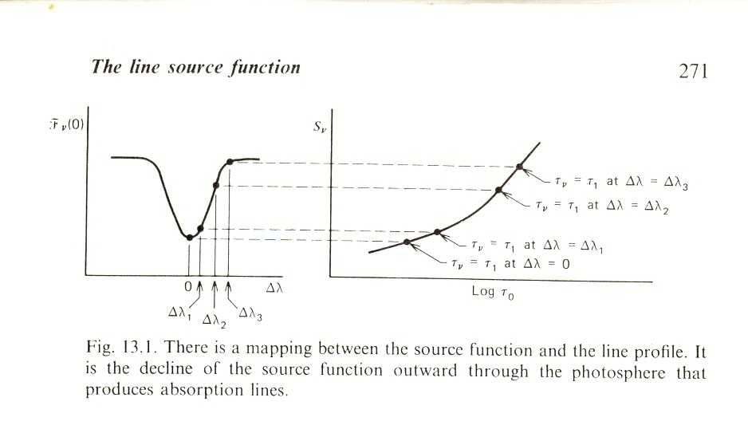
Spectral lines
The larger l_{ν} the smaller x₁ must be to obtain an optical depth τ₁
The flux at the line center (where l_{ν} is maximum) comes from the upper atmospheric layers, where the source function is lower.
x to the star center
Notes:
Tau=0 is the surface, the integration goes from the surfave to x1,
larger is the absorption coeff of the line (lv) shallower is the layer in which this condition is obtained

Slide 12
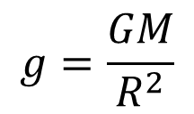
Measuring the gravity in stars
In principle we can measure gravity in a direct way:
• Obtain Mass via spectroscopy and the Doppler effect (binary stars for example)
• Measure the radius by an independent means (interferometry, lunar occultations, eclipsing binaries)
$$g=\frac{GM}{R^{2}}$$
In principle this can only be done for very few stars
must rely on spectroscopic determinations

Slide 13
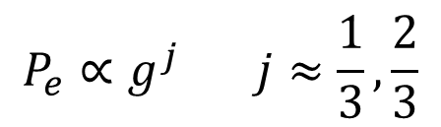
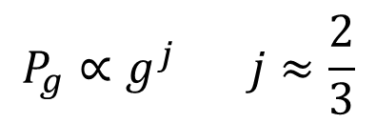
Increasing of gravity translates into a compression of the photosphere and therefore in an increase of the pressure
$$P_{g}∝g^{j} j≈\frac{2}{3}$$
$$P_{e}∝g^{j} j≈\frac{1}{3},\frac{2}{3}$$
Therefore pressure dependences can be translated in gravity dependences
Ionization equilibrium
P sensitive to damping constant for strong lines
P dependence of the linear stark broadening in H

Slide 14



The strenght of a spectral line is related to
the ratio of the line and continuous absorption coefficients:
$$\frac{l_{ν}}{κ_{ν}}$$
Rewrite the Saha equation in a more schematic form
$$\frac{N_{r+1}}{N_{r}}=\frac{Φ(T)}{P_{e}}$$
Number of atoms/ions in r+1 ionization stages
Include all terms not dependent on pressure
Number of atoms/ions in the r ionization stages
Remember also that:
$$l_{ν}∝N_{r}$$

Slide 15


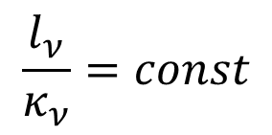


Weak lines (no strong wings) in cool stars
Most part of an element in the next higher ionization stage
$$N_{r+1}≈N_{tot}=const$$
$$N_{r}∝const P_{e}$$
Saha
$$l_{ν}∝N_{r}∝const P_{e}$$
In cool stars H⁻ dominates the opacity of the continuos
$$κ_{ν}∝const P_{e}$$
$$\frac{l_{ν}}{κ_{ν}}=const$$
These lines are insensitive to gravity, but are useful to set the abundance of the element

Slide 16


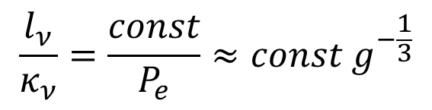

Weak lines (no strong wings) in cool stars
Most part of an element in the same ionization stage
$$N_{r}≈N_{tot}=const$$
$$N_{r}∝const$$
Saha
$$l_{ν}∝N_{r}∝const$$
Again H⁻ dominates the opacity of the continuos
$$κ_{ν}∝const P_{e}$$
$$\frac{l_{ν}}{κ_{ν}}=\frac{const}{P_{e}}≈const{ g}^{−\frac{1}{3}}$$
These lines are sensitive to gravity

Slide 17
Example: in solar like stars iron is mostly ionized
Fe I lines are insensitive to gravity
FeII lines are sensitive to gravity
Fuhrmann et al. (1997) A&A, 323, 909
Procyon
Teff = 6500 K
log g = 3.58
Notes:
Plot: lines of FeI are insensitive to gravity (ab vs log g in constant), lines of FeII are strongly dependent on log g, changing log g we change the abundance
The intersection of the two lines give the value of gravity we are searching for

Slide 18
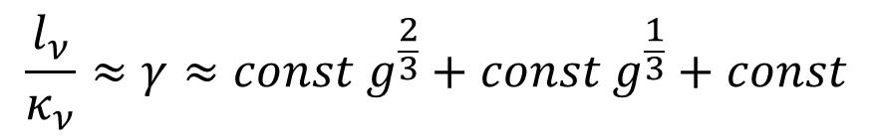






Broad wings of neutral lines in cool stars
$$l_{ν}∝Nγ$$
$$γ_{nat}$$
$$γ_{6}=Φ_{6}\left(T\right)P_{g}≈const{ g}^{\frac{2}{3}}$$
Van der Waals
$$γ_{4}=Φ_{4}\left(T\right)P_{e}≈const{ g}^{\frac{1}{3}}$$
Quadratic Stark
H⁻ dominates the opacity of the continuos
$$κ_{ν}∝const P_{e}$$
Most part of element is ionized
$$N_{r}∝const P_{e}$$
$$\frac{l_{ν}}{κ_{ν}}≈γ≈const{ g}^{\frac{2}{3}}+const{ g}^{\frac{1}{3}}+const$$
Depending of the relative size of damping constants we will have different regimes: from no gravity dependence (γ_{nat} dominant) to maximum dependence (van der Waals dominant)

Slide 19
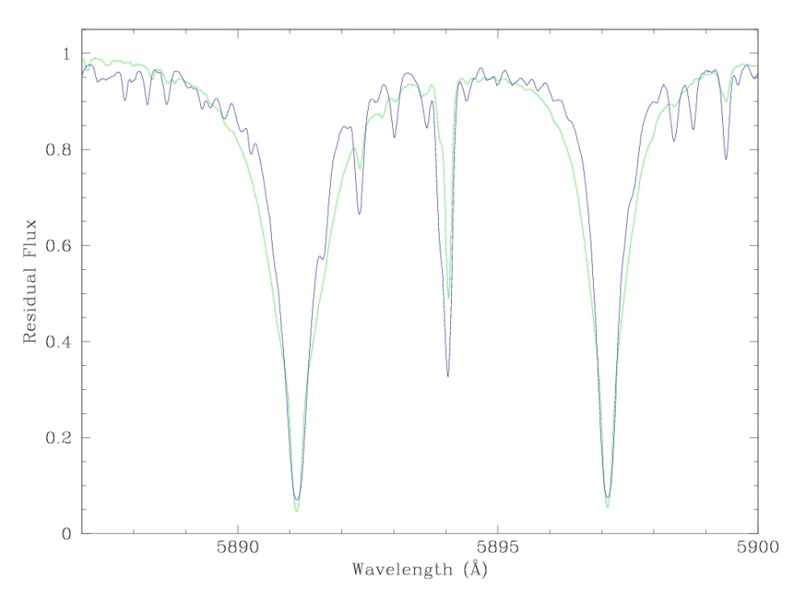
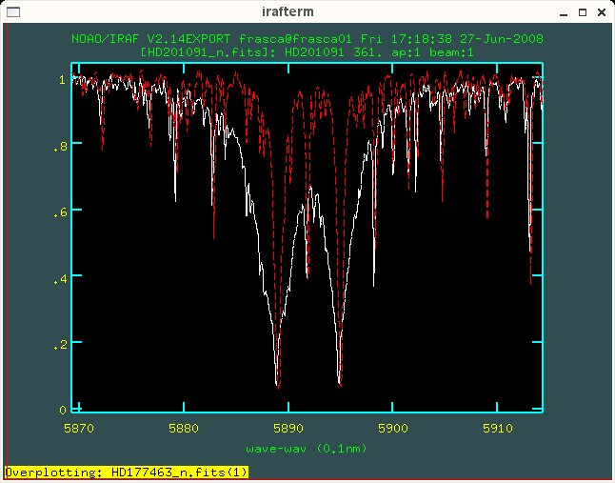
HD100623 K0V
HD99322 K0III
POP-UVES Database
61 Cyg - K5V
T_{eff}=4500 K
logg = 4.57
15 Aql – K1III
T_{eff}=4520 K
logg = 2.65
Courtesy of A. Frasca (Priv. Comm.)
Notes:
Example NaI D sodium lines
Wings broadens with increasing gravity

Slide 20
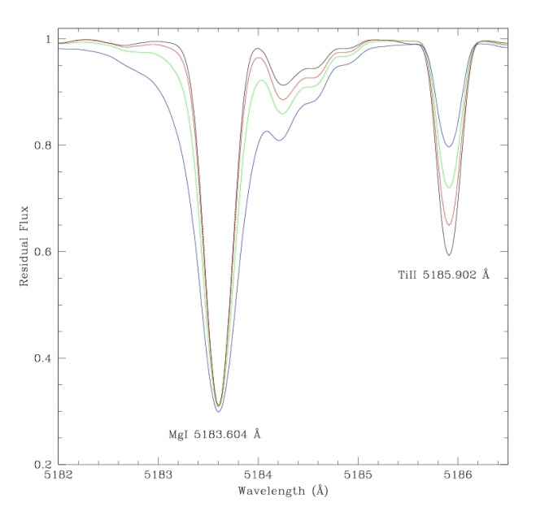
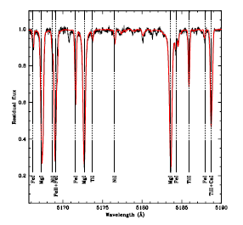
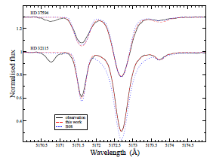
log g = 2.0
log g = 3.0
log g = 4.0
log g = 5.0
HD 71297
T_{eff}=7500 ± 180 K
log g = 4.00 ± 0.10
T_{eff}=7500 K
Teff=7150 K, log g = 4.20
Teff=7380 K, log g = 4.08
Teff=7250 K, log g = 4.20
Teff=7670 K, log g = 4.44
Catanzaro et al (2013), MNRAS, in press
Fossati et al (2011) MNRAS, 417, 495
Notes:
MgI triplet
First plot are synthetic lines computed with same Teff but with different log g, from 2 to 5
There are two lines
TiII weak line: most part of the element in the same ionization stage (sensitive to log g)
MgI broad wing line

Slide 21
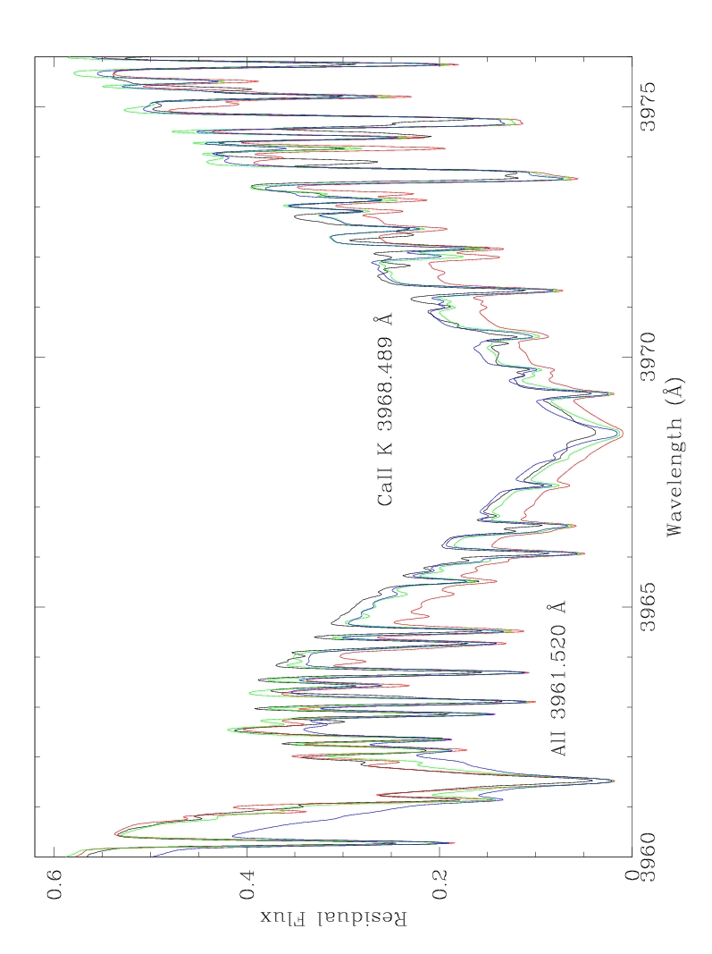
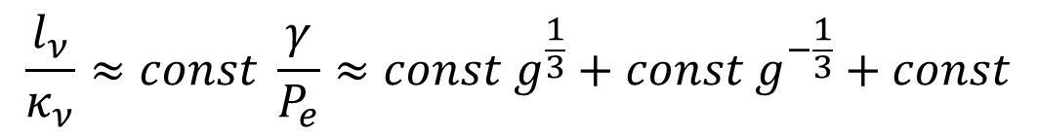
Broad wings of ionic lines in cool stars
$$\frac{l_{ν}}{κ_{ν}}≈const \frac{γ}{P_{e}}≈const{ g}^{\frac{1}{3}}+const{ g}^{−\frac{1}{3}}+const$$
Again, depending we have different regimes: from no gravity dependence (γ_{nat} dominant) to maximum dependence (van der Waals dominant)
HD152311
Teff=5597 K
Log g = 3.97
[Fe/H]=0.10
Vsin i = 4 km/s
Ramirez et al., 2007, 465, 271
Log g = 3, 4, 5
Notes:
Wings broades when gravity decrease

Slide 22
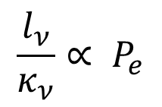
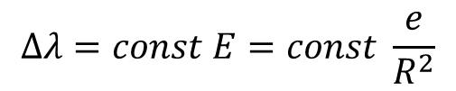
Broad wings of Balmer lines in hot stars
Struve (1929): great wings of Balmer lines in early-type stars are due to linear Stark Effect
R
Distribution of ions gives a non-zero E at the position of the H
The resulting splitting of atomic levels can be expressed as the Δλ of the spectral components:
$$Δλ=const E=const \frac{e}{R^{2}}$$
Greater compression of the photosphere results in a greater E, so l_{ν} is proportional to E and than to P_{e}
In this stars H absorption dominates k_{ν} than it is proportional to N_{H}
$$\frac{l_{ν}}{κ_{ν}}∝ P_{e}$$
H lines increase in strength toward lower luminosity classes

Slide 23
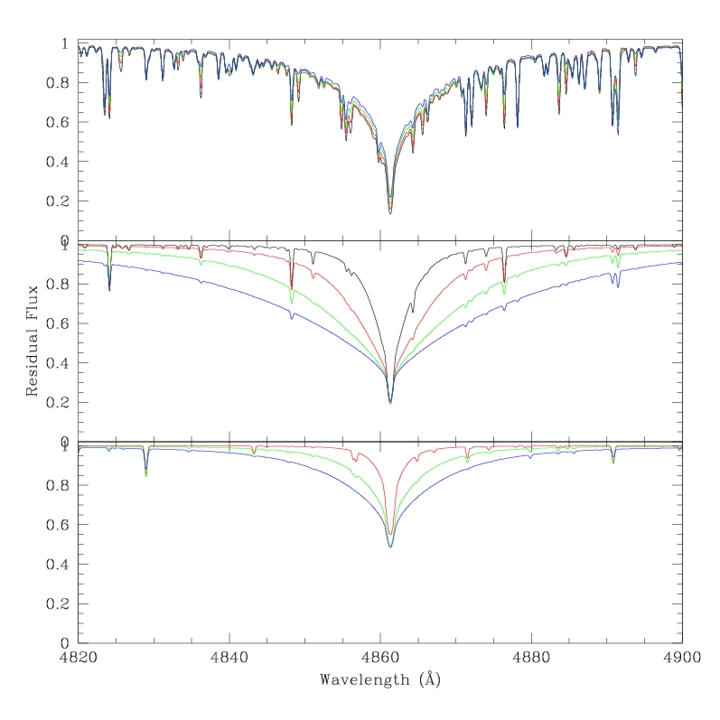
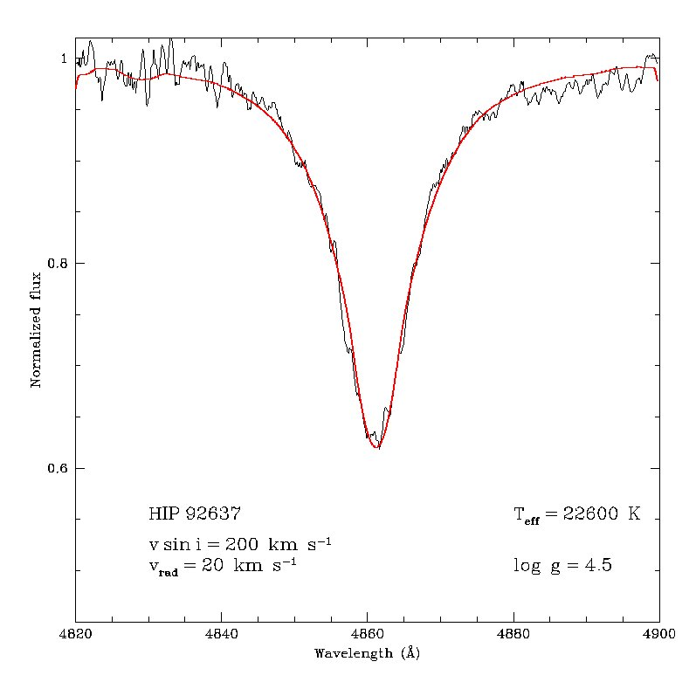

In this case more is the gravity narrow is the line
$$\frac{l_{ν}}{κ_{ν}}∝ P_{e}2$$
log g = 2.0
log g = 3.0
log g = 4.0
log g = 5.0
T_{eff}=7000 K
T_{eff}=10000 K
T_{eff}=25000 K

Slide 24
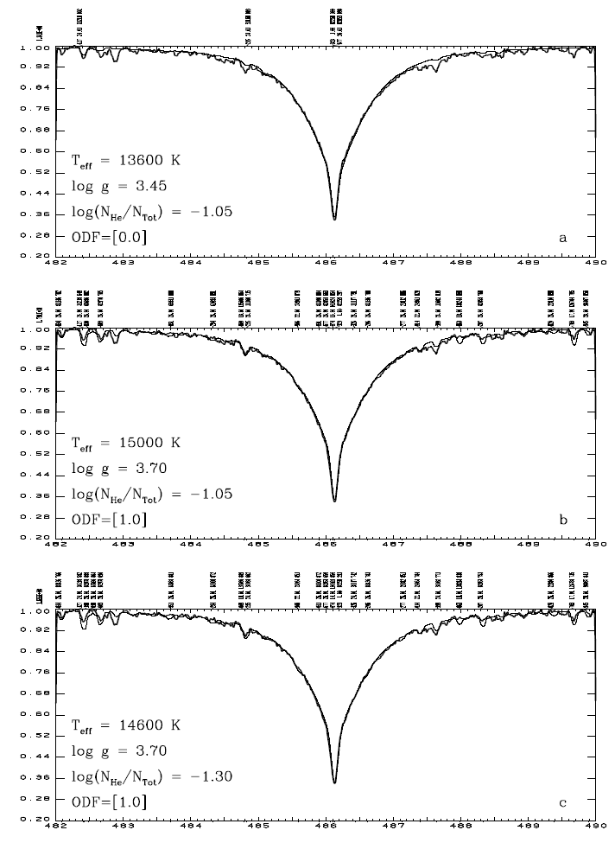
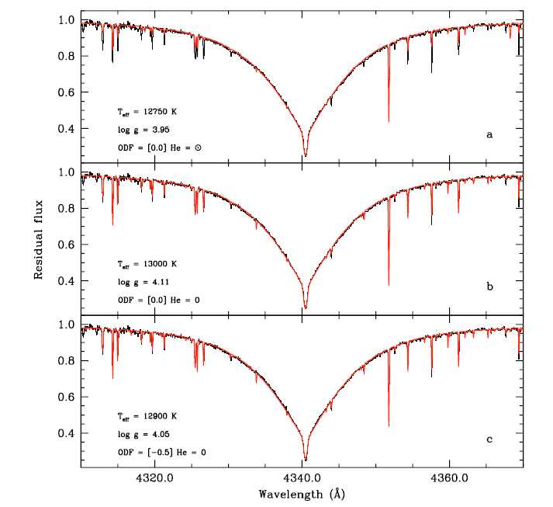
Influence of chemical composition
Catanzaro et al. (2004), A&A, 425, 641
Leone & Manfre’ (1997), A&A, 320, 257

Slide 25
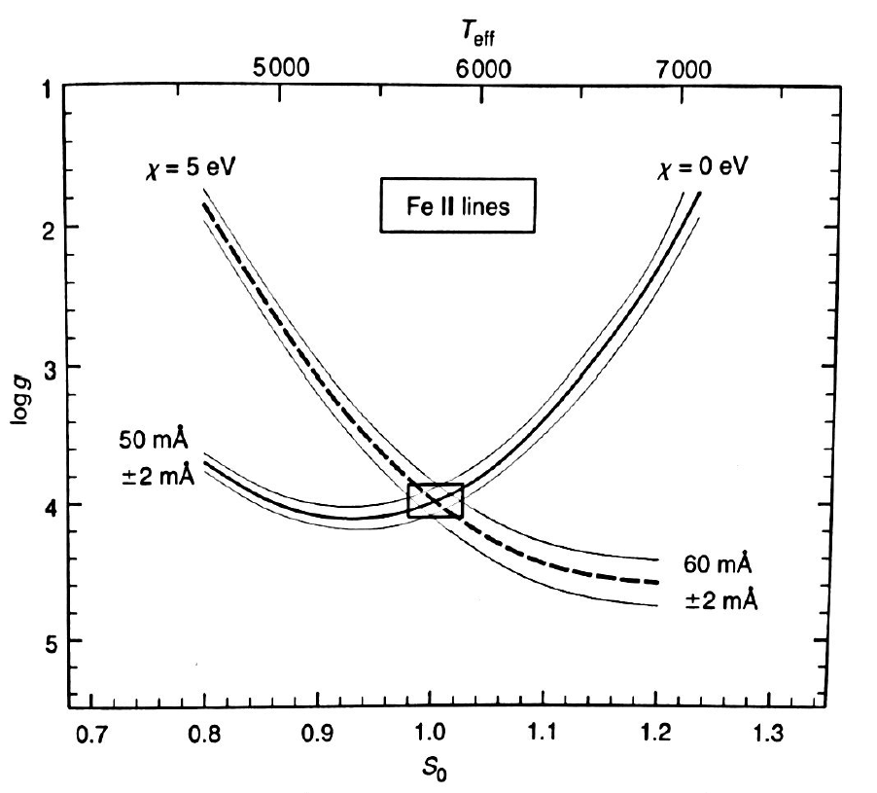
The gravity-temperature diagram
Each curve is computed for a costant iron abundance (fixed using lines not sensitive to g), while varyng the surface gravity for a given temperature (or vice versa) to recover the observed EQWs

Slide 26
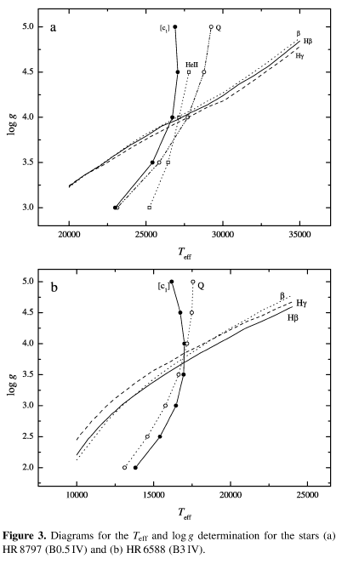
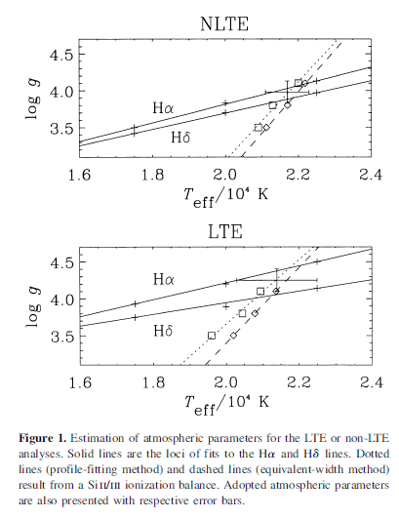
Lehner et al., 2000, MNRAS, 314, 199
Lyumbikov et al., 2002, MNRAS, 333, 9

Slide 27
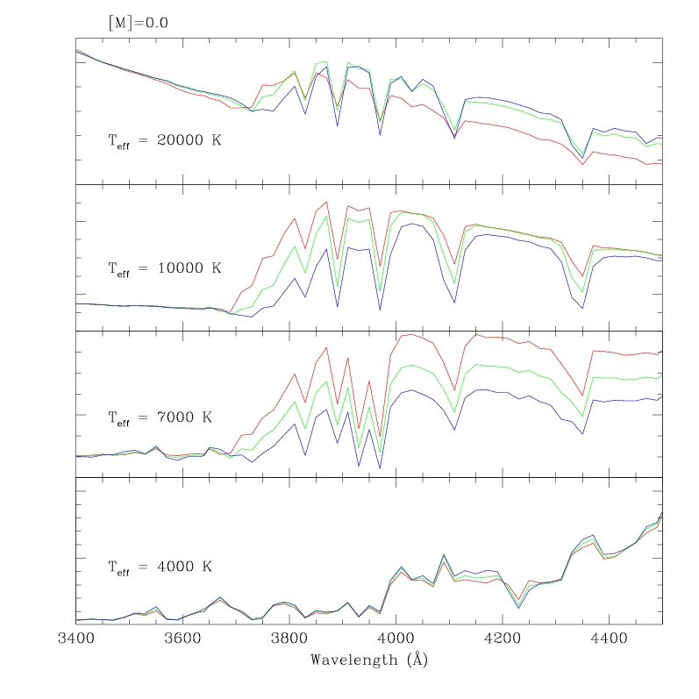
Balmer jump as log g indicator
log g = 3.00
log g = 4.00
log g = 5.00
Notes:
The Balmer jump is the only continuum feature sufficiently sensitive to log g
No useful in cool star: it is masked by the moltitude of metal lines
No useful in hot star: its sensitivity is too small (H ionized)

Slide 28
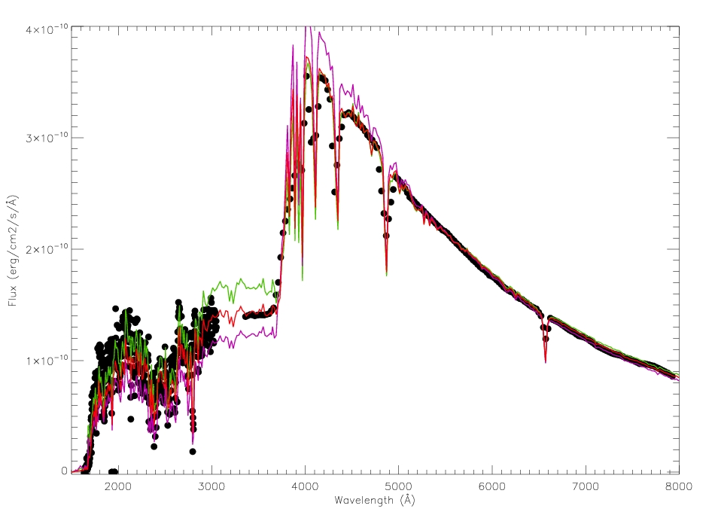
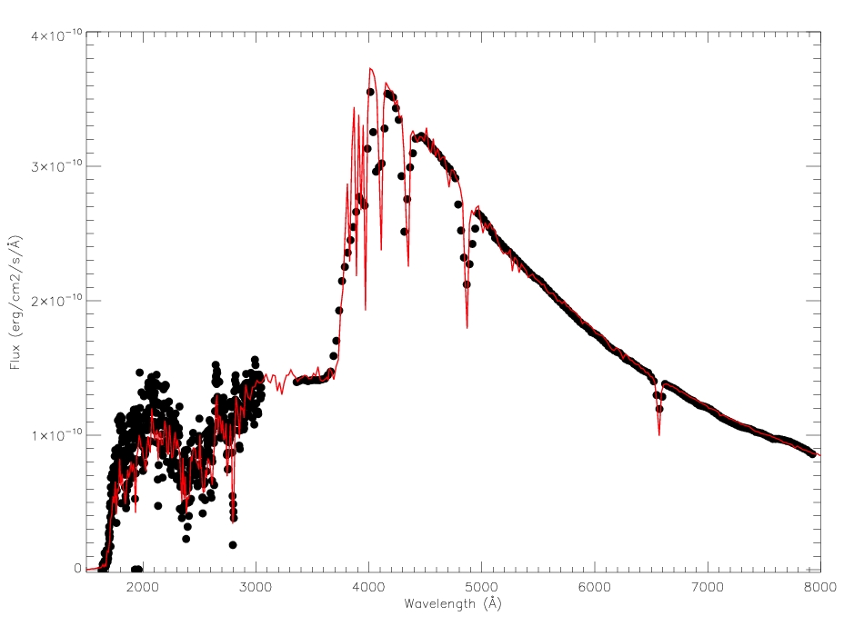
Example: γ Boo T_{eff}=7600 K, log g = 3.7
(Ventura et al., 2007, MNRAS, 381, 164)
log g = 3.00
log g = 4.40

Slide 29
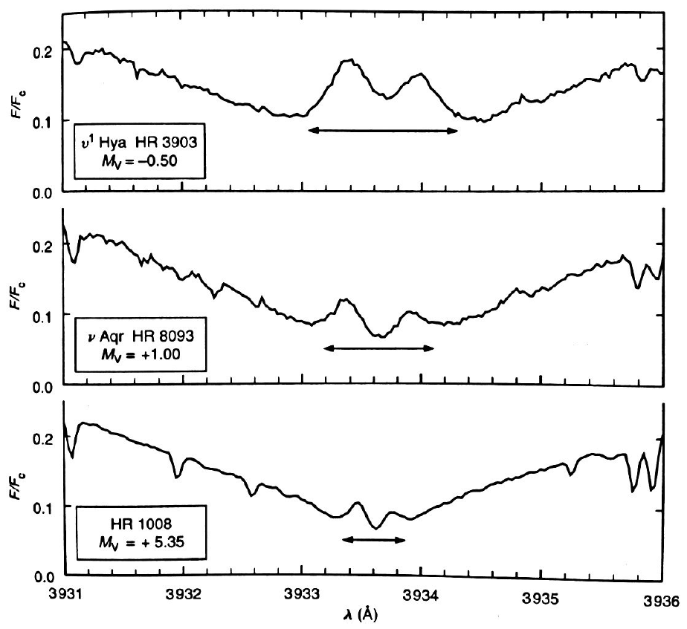
Empirical indicators:
The Wilson-Bappu effect
log g

Slide 30
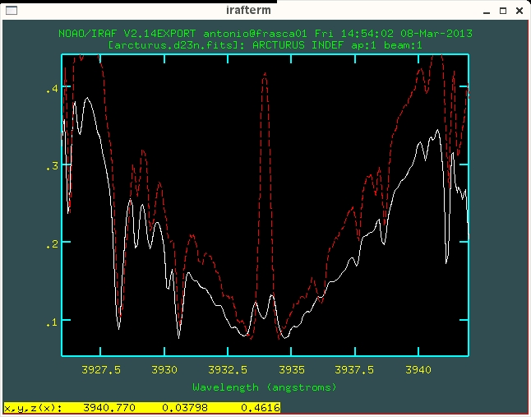
Example: Arcturus (K1.5III) vs ξ Boo A (G8V)
Courtesy of Antonio Frasca
CaII K line
Star | Teff (K) | log g
Arcturus | 4158 ± 127 | 1.89 ± 0.16
ξ Boo A | 5230 ± 115 | 4.58 ± 0.05
Allende-Prieto, 2004, A&A, 420, 183

Slide 31
Thanks for your attention

